Slide 1

Capstone Project
Play Store App Review Analysis
Team Members
Dhawal Khandait
Sakshant Gongal

Slide 2
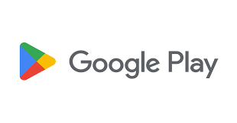

Introduction
The Play Store apps data has enormous potential to drive app-making businesses to success. Actionable insights can be drawn for developers to work on and capture the Android market. Play Store is one of the largest and most popular android app stores with over a millions apps.
Our main objective is to analyze the dataset and find out which features contribute to app success and how these affect the user engagement with the app.

Slide 3
Step Involved
Importing Libraries and Data:- First we imported all the python libraries required for this ,which include NumPy, Pandas, Matplotlib and Seaborn, we read the CSV into a dataframe and pandas dataframe did the work for us.
Data Description:-In this step ,we observed the data by exploring few rows, checking shape, columns, data types etc…
Data Preparation:- Here we carried out data cleaning and data transform to make data efficient for analysis and visulisation.
Data Visulisation:- Visulized data with the help of graphs and plots to learn trends, Patterns and get answers to the questions related to the data . This process helped us figuring out various aspects and relationships among features of the app.

Slide 4
Data Overview
Features:-
App - name of the app
Categories - category of the app
Rating - app’s rating by the users out of 5
Reviews - number of the app’s reviews
Size - size of the app
Installs - number of installs of the app
Type - whether the app is free or paid
Price - price of the app in $
Content Rating - target audience of the app
Genres - genre of the app
Last Updated - date the app updated last time
Current ver. - current version of the app
Android ver. - android version required to run the app
10841 Apps
13 Columns
Different Data Types
String
Integer
Float
Object

Slide 5
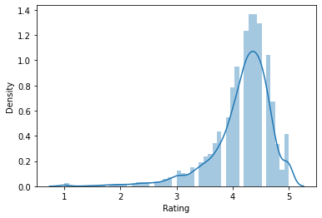
Data Preparation
Missing Data
Overall 1476 null values
Rating has 99% of total missing values
Treating Missing Data
Analyzed features one at a time.
Replaced rating missing values with median value.
Treated other columns missing data in best way possible.

Slide 6
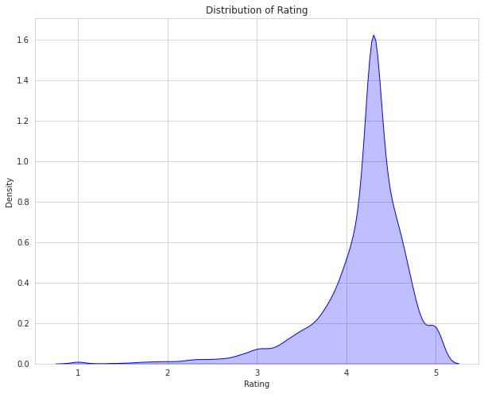
Data Insights
Distribution of Rating
Distribution of rating is negatively skewed.
Average rating is around 4.18
Most of the rating is above 3.5
Rating can be a variable to identify app success.

Slide 7
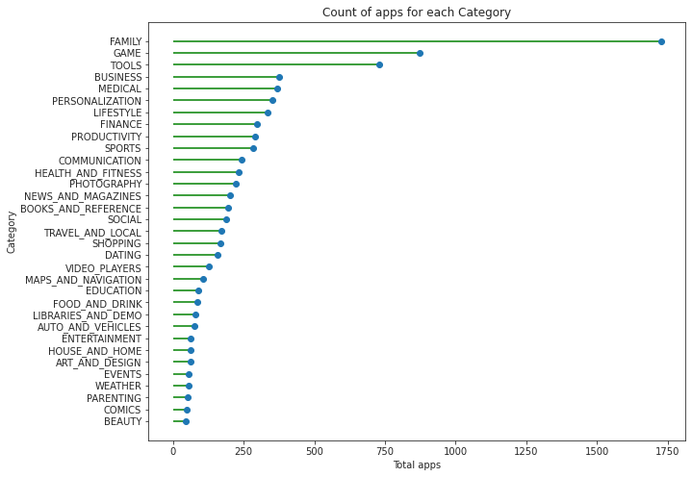
How many apps are there in each category ?
Play store has 33 Categories in total.
Family category has most 1726 apps.
Game and Tools category have 873 and 731 apps respectively.

Slide 8
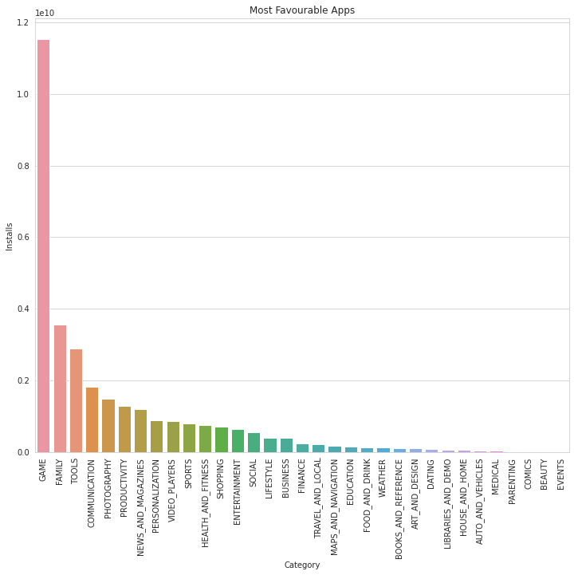
Which category apps are installed most ?
Game is the most popular category.
Entertainment , Communication , Video , Photography categories are also popular among smartphone users.
Medical categories has least number of installs.

Slide 9
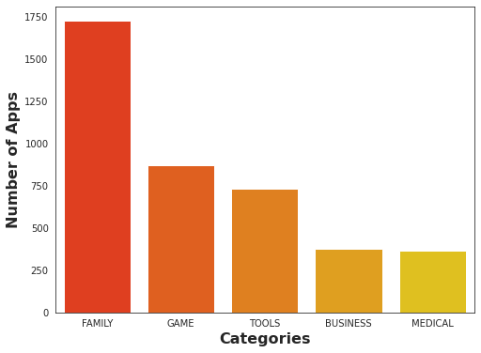
Top 5 Categories in Play Store ?
In this data set top 5 categories are Family, Game, Tools, Business, Medical.
Family category has most apps.
We can conclude most of the users prefers the apps belongs to family category

Slide 10
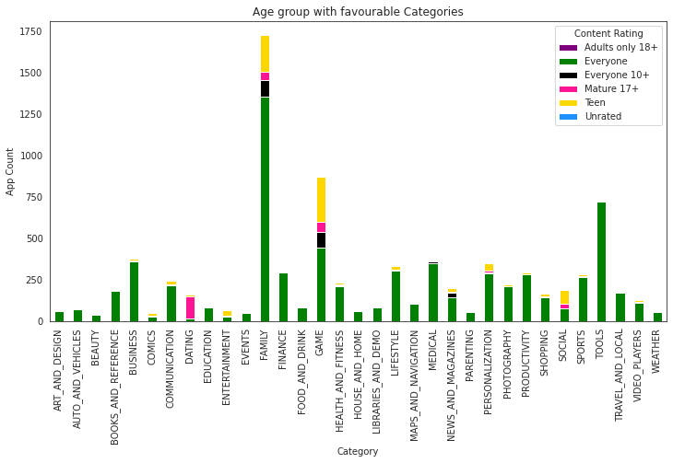
Which age groups do different categories target ?
Every category targets almost all age group audiences.
Dating category has almost all apps for the mature audience.

Slide 11
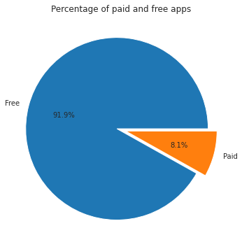
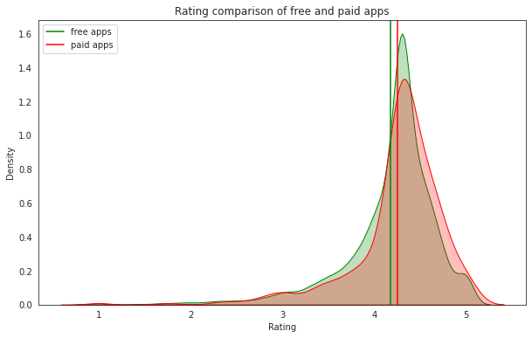
What percentage of apps are paid ?
Do paid apps get better rating ?
Free apps - 7747
Paid apps - 685
The average rating Free apps get is 4.18
The average rating Paid apps get is 4.26

Slide 12
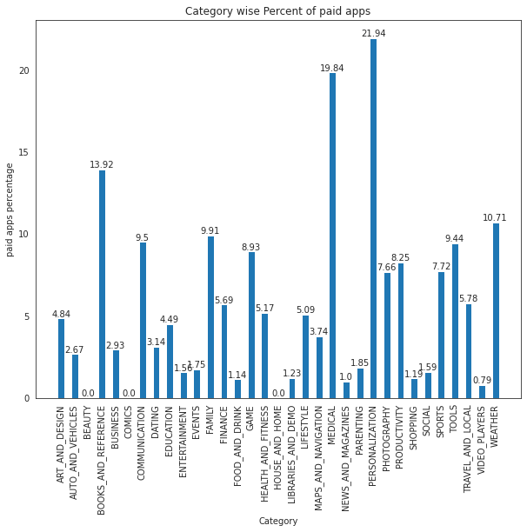
Which type of apps are users willing to pay for ?
Personalization and Medical category have high rate of paid apps.
This type of apps generally do well as paid apps , since value is in the apps functionality.

Slide 13
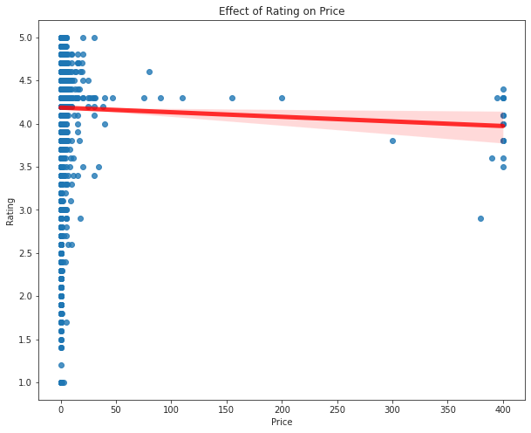
Does rating change with increasing price ?
Bivariate Analysis
Majority of apps cost below $100.
There is negative relation between price and rating.
Rating decreases with increasing price.

Slide 14
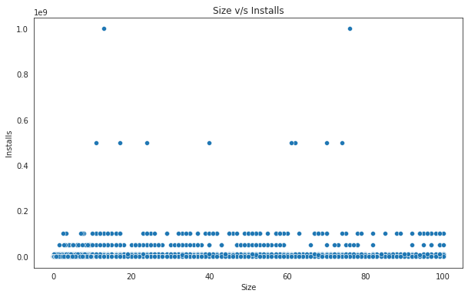
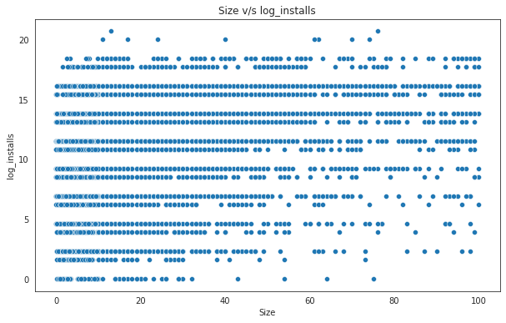
Does the size of an app influence the installs ?
Before Log Transformation
After Log Transformation

Slide 15
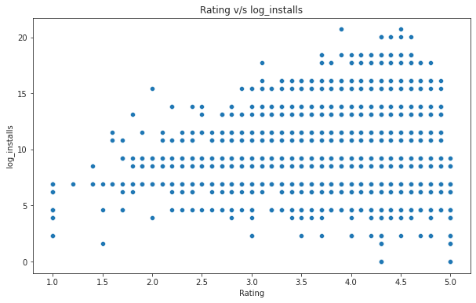
Do higher rated apps attract more users ?
Both are the most important features to look after.
Apps with rating around 4.5 have more installs.
Users prefer highly rated apps to download.

Slide 16
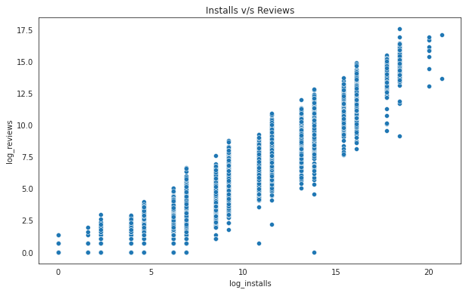
How reviews affect users decision to download apps ?
Popular apps tend to get more reviews.
Users read the reviews which attract them to install the app.

Slide 17
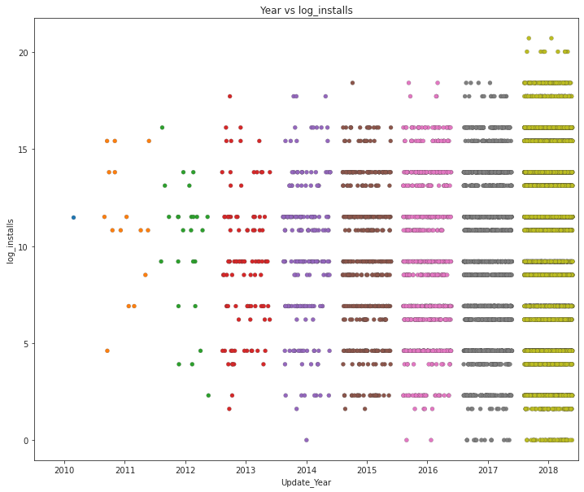
Are app updates important ?
Most of the apps get frequent updates.
Updating apps can improve the user experience .
Leads to more convenience and increased engagement in the use of the app.

Slide 18
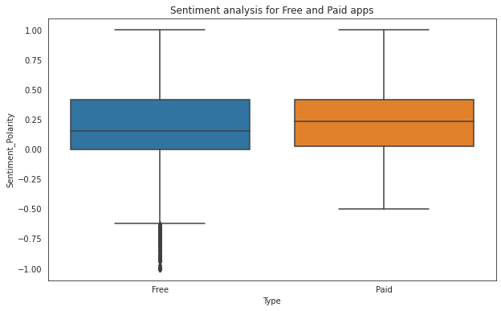
Sentiment analysis for free and paid apps
Free apps get more negative reviews.
Median polarity is higher for paid apps.

Slide 19
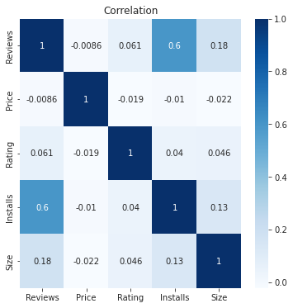
Correlation Heatmap
Installs and Reviews have the strongest correlation
Rating has. negative relation with Price
Installs has positive relation with Size but it is very weak.

Slide 20
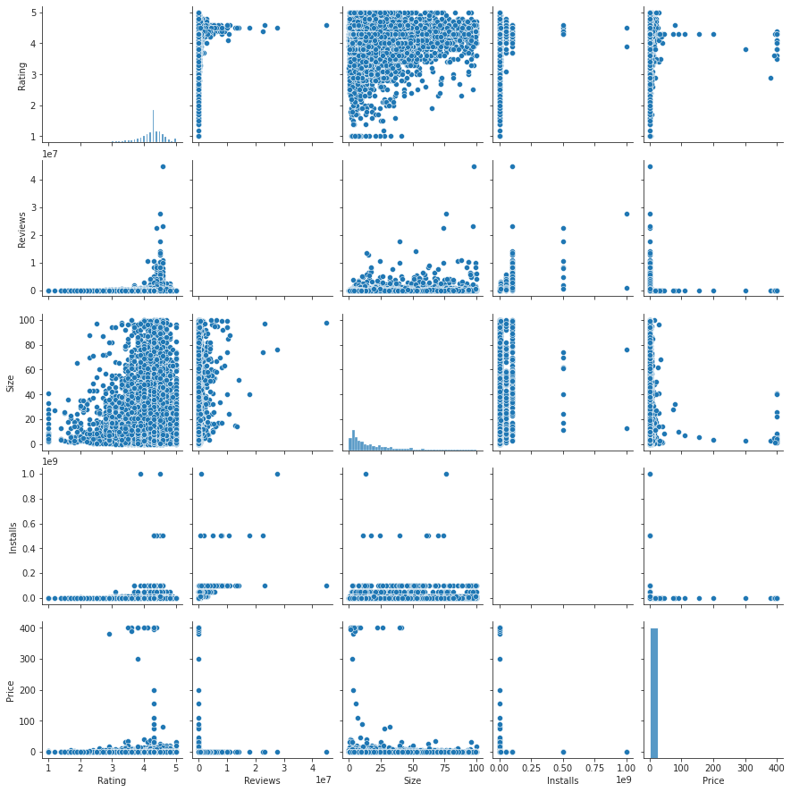
Pair Plot

Slide 21
Conclusion
Family category has more apps on the play store but Game category is the most popular category.
Approx. 91% apps on play store are free apps and Medical and Personalization apps generally do well as paid apps.
Users prefer apps that required less space .Bulky apps are downloaded less.
App ratings and reviews have a significant impact on a user's decision to download or to download an app.
Updating the app can improve user experience and happy users attract more new users.
Sentiments in reviews also matters in attracting new users as other user's positive reviews about the app strength then the decision to download.

Slide 22
Challenges
Data cleaning was the most time consuming phase and whether to drop the null values or fill them was the real challenge.
Installs and reviews were highly skewed and getting undesirable results lead to lots of search reaching to a solution of log transformation.
Reviews dataset has so much data and it was little difficult to handle.

